Slide 1

MISSOURI will soon join
SARA
What does that mean for my institution?
July 18, 2014
Jenny Parks,
Director, M-SARA,
Midwestern Higher Education Compact (MHEC)

Slide 2

ACKNOWLEDGEMENT
Funding for national and regional implementation provided by
2

Slide 3
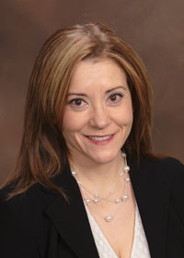
Jennifer L. Parks, M.A.
Director, Midwestern Regional State Authorization Reciprocity Agreement (M-SARA)
Midwestern Higher Education Compact
jennyp@mhec.org
(608) 461-0138
3

Slide 4
Structure of the Webinar
Total Webinar Time = 60 minutes
Part I:
Quick State Authorization and SARA overview with implementation timeline and comment on federal rulemaking
Part II:
A quick walk through the state and institutional application process
Part III:
Questions and Answers
4

Slide 5
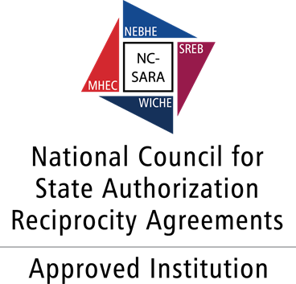
PART I:
A Quick State Authorization and SARA Overview
5

Slide 6


State Authorization 101
October 29, 2010, Program Integrity Rules
Great history and overview: http://wcet.wiche.edu/advance/state-approval
Best list of requirements in each state: http://sheeo.org/sheeo_surveys/
M-SARA Webinar from April 2014: https://www.youtube.com/watch?v=ilPFNLo38os
6

Slide 7
Quick SARA Overview
Institutional academic integrity
Institutional financial responsibility
Triggers for “physical presence”
Complaint processing
Data collection and sharing
Accountability for institutional catastrophes
7

Slide 8
PART II:
A Walk Through the State Institutional Application Process
Jenny Parks
8

Slide 9
Stages to SARA membership
STAGE 1
A state must have the legal ability to join the agreement
Estimates:
20-24 states by end of 2014
40-45 states by end of 2015
9

Slide 10
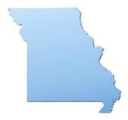
Stages to SARA membership
STAGE 1
Missouri has passed its legislation and the governor has singed it into law, which enacts
8/28/14
SB 699: http://www.senate.mo.gov/14info/BTS_Web/BillText.aspx?SessionType=R&BillID=28273750
10

Slide 11
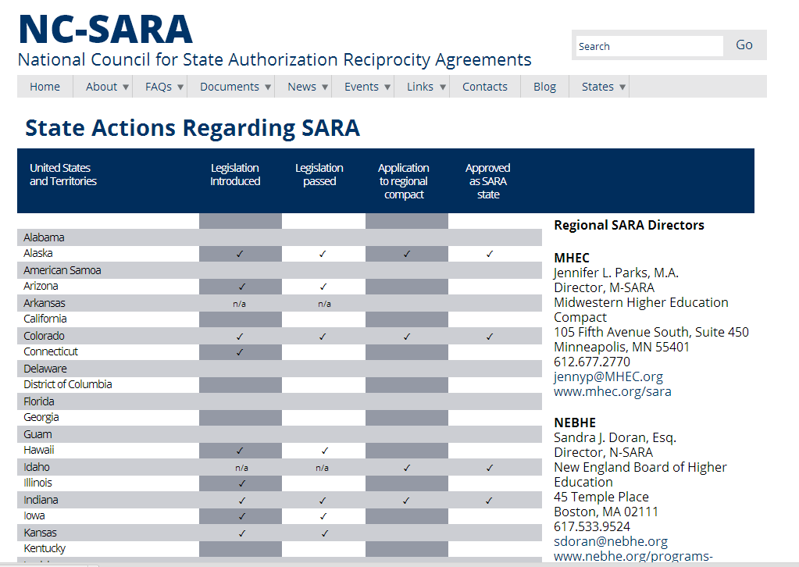
National SARA Progress and
State Membership Update
http://www.nc-sara.org/content/sara-state-status
11

Slide 12
Stages to SARA membership
STAGE 2
A state must set up its state portal agency (SPA) and the means by which it carries out its SARA duties
12

Slide 13
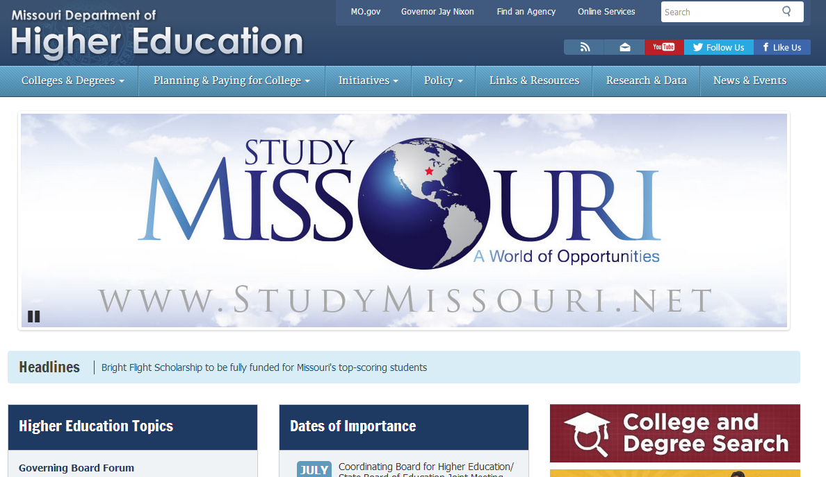
Stages to SARA membership
STAGE 2
In MO, that will be the Missouri Department of Higher Education:
http://dhe.mo.gov/
13

Slide 14
Stages to SARA membership
STAGE 3
A state must submit its application to its regional compact and be approved for membership
MO will likely submit its application in
Fall of 2014
14

Slide 15
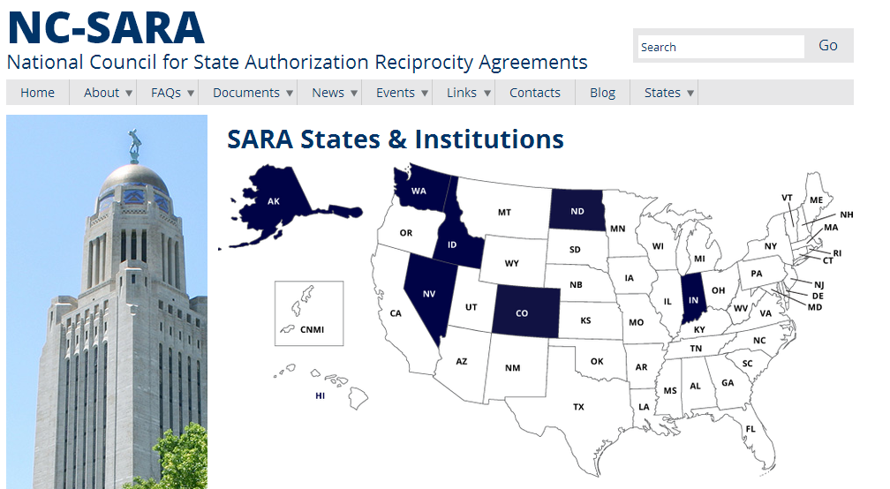
Examples of states that have already joined SARA
http://nc-sara.org/sara-states-institutions
15

Slide 16
Stages to SARA membership
STAGE 4
Institutions apply to their SPAs once the SPAs are ready for them
MO institutions can likely submit applications by November 2014
16

Slide 17
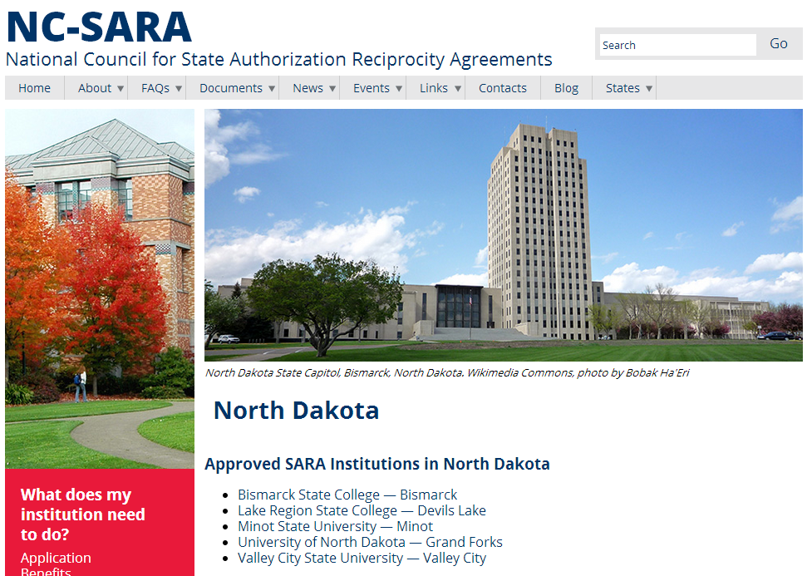
Examples of Institutions that have already joined SARA http://nc-sara.org/states/nd
17

Slide 18
Estimated timeline for M-SARA SPAs to accept Institutional applications
States | Estimated SPA opening
Indiana North Dakota | Already taking applications
Illinois, Kansas, Minnesota, Nebraska | Fall 2014
Iowa, Missouri, Ohio | January 2015
Michigan | Summer 2015
18

Slide 19
Estimated timeline for W-SARA SPAs to accept Institutional applications
States | Estimated SPA opening
Idaho, Nevada | Already taking applications
Alaska, Colorado, Washington | July 2014
Montana | State application just submitted
19

Slide 20
How an Institution can Apply for SARA participation
Three places to find the application
  NC-SARA Website
    http://nc-sara.org/files/docs/SARA-Institutional-Application.pdf.pdf
  MHEC Website
    http://www.mhec.org/sara-documents
  SPA Website
20

Slide 21
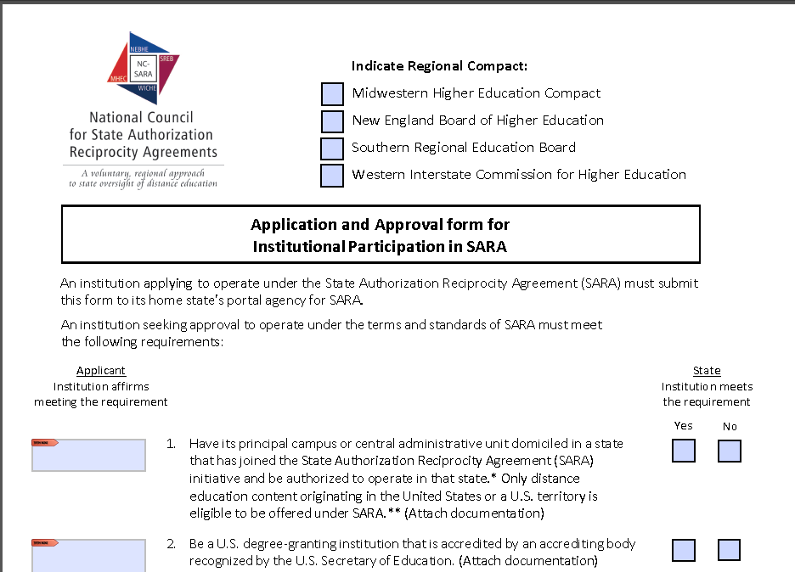
Institutional SARA application and C-RAC Guidelines
For a step-by-step walk through the institutional application, please see MHEC webinar from June 18, 2014:
https://www.youtube.com/watch?v=UFyo9xWOPtY
21

Slide 22
What are the parts of the Application?
 | Same for all states | Different by state (Page 8 only)
Requires documentation | Items 1, 2, & 3 OPE ID – location Accreditation FRS | State Fees Surety Bonding Low FRS documentation
Requires Affirmation | Everything else ** C-RAC Guidelines**
22

Slide 23
What’s different by states?
State Fees
Various models have been discussed in all the states; in IN and ND there are no state fees.
MO fees have not been set yet.
23

Slide 24

What’s different by states?
Surety Bonds
In some states nothing will change; in some states there is discussion of extending bonding to independent institutions in order to manage the risk of larger numbers of out-of-state students.
No changes to bonding are expected in MO at this time.
24

Slide 25
What’s different by states?
Financial Responsibility Scores
Some states will not accept the lower scores, while some have discussed accepting a score of 1.0 without documentation as long as the school is still eligible to receive Title IV funds.
MO will likely review these on a case-by-case basis.
25

Slide 26
PART III:
Questions and Answers
Federal Rule making (August 14th webinar)
Clinical/experiential learning/internships (August 19th webinar)
Professional Licensure (August 19th webinar)
And much, much more…
26

Slide 27

More Information?
NC-SARA website: www.nc-sara.org
Regional Education Compacts:
  MHEC – www.mhec.org
  NEBHE – www.nebhe.org
  SREB – www.sreb.org
  WICHE – www.wiche.edu
27

Slide 28
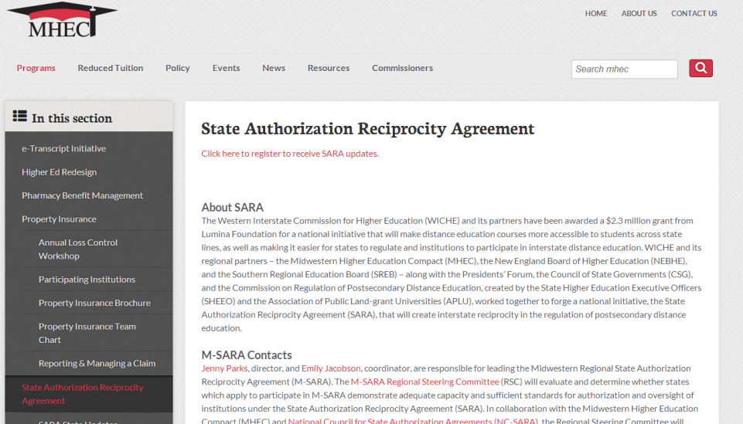
More Information?
Sign up for MHEC and M-SARA information with this link:
http://storage.mhec.org/library/b43d30c1-c560-e211-8dcf-00155d323067/1350/webforms/208d1d71-0acf-e311-aa04-d4ae5299785c.htm?rnd=829184
28

Slide 29
More Information?
Upcoming Webinars:
http://www.mhec.org/sara-webinars
August 14th and 19th, 2014
State Authorization for Distance Education:
    The Future for REGULATIONS
State Authorization for Distance Education:
  The Future for RECIPROCITY
29

Slide 30
Questions?
Marshall A. Hill, Ph.D.
Executive Director
National Council for State
Authorization Reciprocity Agreements
3005 Center Green Drive, Suite 130
Boulder, CO 80301
303.541.0283 l mhill@nc-sara.org
www.nc-sara.org
Sandra J. Doran, Esq.​
Director, N-SARA
New England Board of Higher Education
45 Temple Place
Boston, MA 02111
617.533.9524​
sdoran@nebhe.org​
www.nebhe.org
John Lopez, Ph.D.
Director, W-SARA
Western Interstate Commission for
Higher Education (WICHE)
3005 Center Green Drive, Suite 130
Boulder, CO 80301
303.541.0277
jlopex@wiche.edu
www.wiche.edu
Mary A. Larson, M.Ed.
Director, S-SARA
Southern Regional Education Board (SREB)
592 10th Street N.W.
Atlanta, GA 30318-5776
404.875.9211 ext. 219 l mary.larson@sreb.org
www.sreb.org
Jennifer L. Parks, M.A.
Director, M-SARA
Midwestern Higher Education Compact (MHEC)
105 Fifth Avenue South, Suite 450
Minneapolis, MN 55401
612.677.2770 l jennyp@MHEC.org
www.mhec.org
Emily M. Jacobson
Coordinator, M-SARA
Midwestern Higher Education Compact (MHEC)
105 Fifth Avenue South, Suite 450
Minneapolis, MN 55401
612-677-2771
emilyj@mhec.org
www.mhec.org
30

